Slide 1
Entity Framework
Course Code: CSC 4164
Course Title: ADVANCED PROGRAMMING WITH .NET
Dept. of Computer Science
Faculty of Science and Technology
Lecture No: | 08 | Week No: | 05 | Semester: | Fall 2020-21
Lecturer: | Victor Stany Rozario, stany@aiub.edu

Slide 2
Lecture Outline
Definition of EF
ADO.NET VS EF
Installing and configuring EF
Introduction to LINQ and Lambda Expression
CRUD operations using EF Schema-First approach
CRUD operations using EF Code-First approach

Slide 3
Entity Framework
Definition of EF
Microsoft has provided an O/RM framework called "Entity Framework" to automate database related activities for your application.
ADO.NET entity is an ORM (object relational mapping) which creates a higher abstract object model over ADO.NET components. So rather than getting into dataset, datatables, command, and connection objects as shown, you work on higher level domain objects like customers, suppliers, etc.
ADO.NET is the oldest Microsoft data access framework. It shipped in the original release of .NET Framework and has proven to be stable and dependable. ADO.NET is a set of libraries that supports interactions with many data sources.

Slide 4
Writing and managing ADO.Net code for data access is a tedious and monotonous job.
As developers work with strongly typed .NET objects called entities, there was a big gap between the object models used in the Object-Oriented Programming (OOP) and the data storage, which is in a relational model. Much code was needed to deal with this gap. ORM was created to resolve this issue. It is a technique for converting data stored in a relational database to domain-specific classes.
Entity Framework offers many benefits compared to previous technology. One of its advantages is the excellent tooling support where we can build and maintain data access in a much shorter time. We can focus on solving business problems without worrying about the underlying data storage.

Slide 5
Entity Framework Features
Cross-platform: EF Core is a cross-platform framework which can run on Windows, Linux and Mac.
Modelling: EF (Entity Framework) creates an EDM (Entity Data Model) based on POCO (Plain Old CLR Object) entities with get/set properties of different data types. It uses this model when querying or saving entity data to the underlying database.
Querying: EF allows us to use LINQ queries (C#/VB.NET) to retrieve data from the underlying database. The database provider will translate this LINQ queries to the database-specific query language (e.g. SQL for a relational database). EF also allows us to execute raw SQL queries directly to the database.
Change Tracking: EF keeps track of changes occurred to instances of your entities (Property values) which need to be submitted to the database.
Saving: EF executes INSERT, UPDATE, and DELETE commands to the database based on the changes occurred to your entities when you call the SaveChanges() method. EF also provides the asynchronous SaveChangesAsync() method.

Slide 6
Entity Framework Features
Concurrency: EF uses Optimistic Concurrency by default to protect overwriting changes made by another user since data was fetched from the database.
Transactions: EF performs automatic transaction management while querying or saving data. It also provides options to customize transaction management.
Caching: EF includes first level of caching out of the box. So, repeated querying will return data from the cache instead of hitting the database.
Built-in Conventions: EF follows conventions over the configuration programming pattern and includes a set of default rules which automatically configure the EF model.
Configurations: EF allows us to configure the EF model by using data annotation attributes or Fluent API to override default conventions.
Migrations: EF provides a set of migration commands that can be executed on the NuGet Package Manager Console or the Command Line Interface to create or manage underlying database Schema.

Slide 7
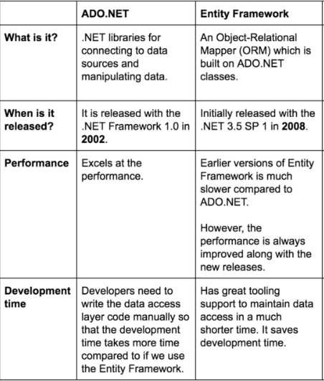
ADO.NET VS EF

Slide 8
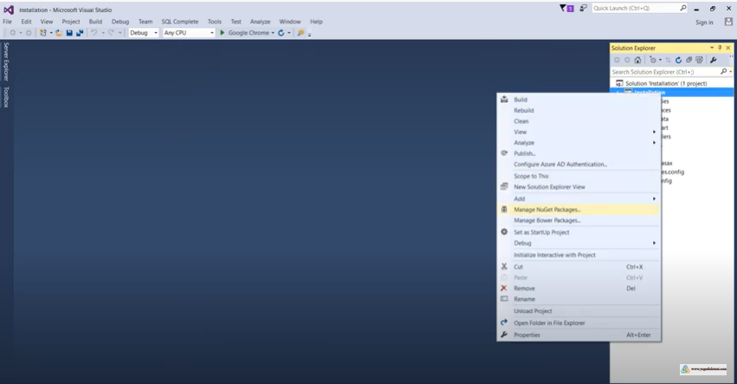
Installing EF
Right click on the project in the Solution Explorer in Visual Studio and select Manage NuGet Packages.. (or select on the menu: Tools -> NuGet Package Manager -> Manage NuGet Packages For Solution).

Slide 9
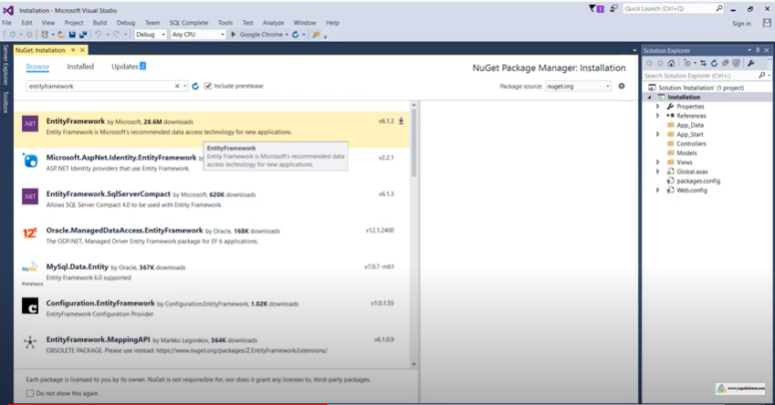
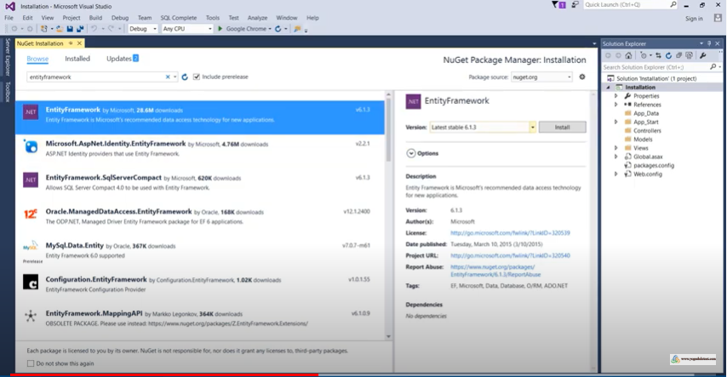
Installing EF
Select Browse on the top and search Entity framework on the search list. Select Entity framework and then click “Install”.

Slide 10
Installing EF
Select Browse on the top and search Entity framework on the search list. Select Entity framework and then click “Install”. After that it again asks for approval so just click onto “OK”. Afterwards accept the conditions.

Slide 11
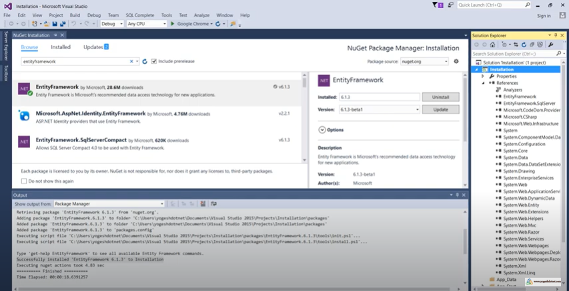
Installing EF
You will then find the package install and to check it, click onto “References” from the Solution Explorer. You will see the references of Entity Framework and Entity Framework SqlServer.

Slide 12
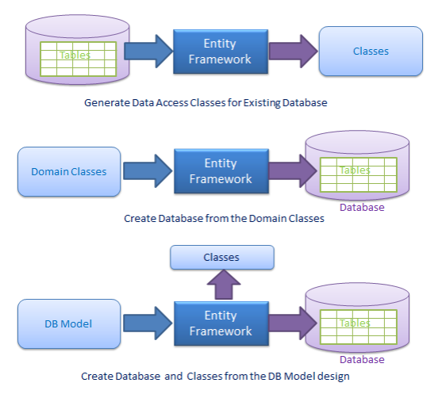
Below is the code for Entity Framework in which we are working on higher level domain objects like customer rather than with base level ADO.NET
components (like dataset, datareader, command, connection objects, etc.).
DataTable table = adoDs.Tables[0];
for (int j = 0; j < table.Rows.Count; j++)
{
DataRow row = table.Rows[j];
// Get the values of the fields
string CustomerName =
(string)row["Customername"];
string CustomerCode =
(string)row["CustomerCode"];
}
foreach (Customer objCust in obj.Customers)
{ }

Slide 13
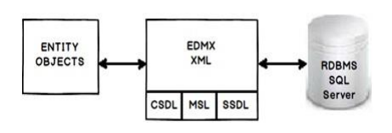
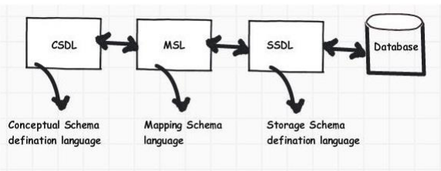
EDMX file
•CSDL (Conceptual Schema definition language) is the conceptual abstraction which is exposed to the application.
•SSDL (Storage Schema Definition Language) defines the mapping with your RDBMS data structure.
•MSL (Mapping Schema Language) connects the CSDL and SSDL.

Slide 14
Introduction to LINQ
C# provides a mechanism for querying collections known as LINQ-Language Integrated Query.
• LINQ enables access to collections (and databases) using query expressions which are similar to SQL queries
• This allows the retrieval of information from a wide variety of data sources.
• .NET also provides LINQ providers for :
• LINQ to SQL
• For querying databases
• LINQ to XML
• For querying xml documents
• We can design a simple LINQ query which filters the contents of an array

Slide 15
Querying an array
A simple query object comprises from, where and
select clauses
•Also, we can make use of the keyword var which is an implicit type
In the next slide we will see an example of accessing an array by LINQ.
• IEnumerable<T> is an interface implemented by arrays and
collections
• It is a generic type
• We replace the T by a real type (such as an int)
var filteredArray =
from ...... // range variable and data source
where ..... // boolean expression
select..... // which value appears in the results

Slide 16
using System;
using System.Collections.Generic;
using System.Linq;
class LINQtoArray
{
static void Main(string[] args)
{
int[] array = { 2, 6, 4, 12, 7, 8, 9, 13, 2 };
var filteredArray = // LINQ query
from element in array
where element < 7
select element;
PrintArray(filteredArray, "All values less than 7:");
}
public static void PrintArray(IEnumerable<int> arr, string message)
{
Console.Write("{0}",message);
foreach (var element in arr)
Console.Write(" {0}", element);
Console.WriteLine();
}
}

Slide 17
We can add the orderby (descending) clause to our query to sort ouT filtered array into ascending (descending) order.
var filteredArray =
from ...... // range variable and data source
where ..... // boolean expression
orderby ..... (descending) // sort
select..... // which value appears in the results
It's important to understand a feature of LINQ known as deferred execution
• The result of a LINQ query expression is not a sequence or collection of objects but a query object
• It represents the commands needed to execute the query
• The query does not execute until the program requests data from the query object
• Deferred execution is a powerful feature of LINQ as it allows applications to pass queries around as data
• In our simple example, the query is not run until it is passed to the PrintArray method

Slide 18
Introduction to Lambda Expression
A lambda expression is an anonymous function that you can use to create delegates or expression tree types. By using lambda expressions, you can write local functions that can be passed as arguments or returned as the value of function calls. Lambda expressions are particularly helpful for writing LINQ query expressions. To create a lambda expression, you specify input parameters (if any) on the left side of the lambda operator =>, and you put the expression or statement block on the other side. For example, the lambda expression x => x * x specifies a parameter that’s named x and returns the value of x squared. You can
assign this expression to a delegate type, as the following example shows:
delegate int del(int i);
static void Main(string[] args)
{
del myDelegate = x => x * x;
int j = myDelegate(5); //j = 25
}

Slide 19
Expression Lambdas
A lambda expression with an expression on the right side of the => operator is called an expression lambda. Expression lambdas are used extensively in the construction of Expression Trees (C# and Visual Basic). An expression lambda returns the result of the expression and takes the following basic form:
(input parameters) => expression
The parentheses are optional only if the lambda has one input parameter; otherwise they are required. Two or more input parameters are separated by commas enclosed in parentheses:
(x, y) => x == y
Sometimes it is difficult or impossible for the compiler to infer the input types. When this occurs, you can specify the types explicitly.
Statement Lambdas
A statement lambda resembles an expression lambda except that the statement(s) is enclosed in braces:
(input parameters) => {statement;}
Details will be covered in the notes.

Slide 20
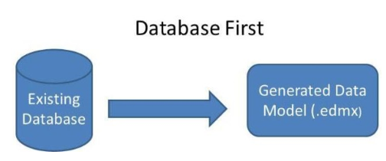
CRUD operations using EF Schema-First approach
Database First is nothing but only a approach to create web application where database is available first and can interact with database. Database is created first and after that we manage the code. The Entity Framework is able to generate a business model based on the tables and columns in a relational database.

Slide 21
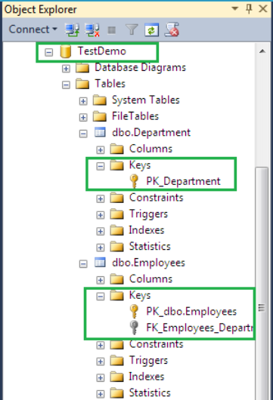
To create a new database first open “Microsoft SQL Server Management Studio” and Right click on Database and choose New Database.
It will open a New Database Dialog where you can define your database structure. You need to provide the database name “TestDemo” and click to OK. It will add a new database for you. You can check it into the Object Explorer.
Create some table which will participate in CRUD operations. We are going to create two tables “Employee” and “Department” and make relationship between both.

Slide 22
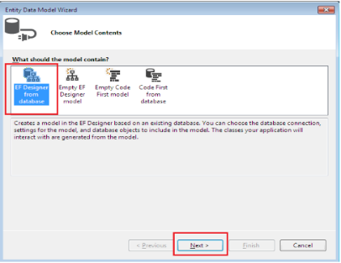
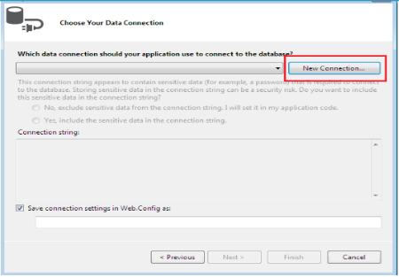
Create new ASP.NET Web application in Visual Studio.
Create models from existing database. To Add Models, Right Click on Models folder and choose Add and then choose New Item. Choose Data node then ADO.NET Entity Data Model, provide the valid name and click OK.
In the Entity Data Model Wizard, select EF Designer from database and Click Next.
Click the New Connection button. where you will define the database connection.

Slide 23
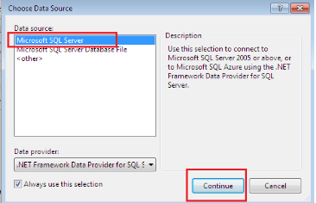
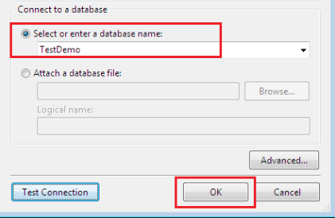
In the Choose Data Source window, we need to choose Data Source and click to Continue.
It will open a new dialog where you need to specify everything about database connection such as Server name. Here choose Windows Authentication and also choose the database. Select our database name.
It will create database connection string in the Entity Data Model Wizard. Click to Next.
From the next Entity Data Model Wizard, we can choose database items like Tables, Views, Stored Procedures and Function. Choose as per your requirement and pass the Model Name and click to Finish..

Slide 24
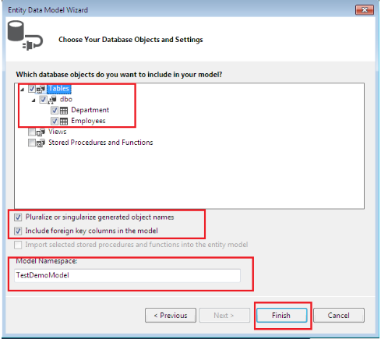
The DemoDataModel.Context.cs file contains a class that derives from the DbContext class. It also provides a property for each model class that corresponds to a database table. The Department.cs and Employee.cs files contain the model classes that represent the databases tables. Here you can see Department.cs and Employee.cs represent the database the database table. They contain all columns as properties.

Slide 25
Before proceeding to move forward build the application. We have added database with tables and implemented it with Entity Data Model which has been created model classes. So, it is time to create User Interface [Views] which will used to perform user operation like here we can add data, select data, edit data and delete data.
To add new controller, Right click on Controller folder and choose Add and choose Add Scaffolded Item.
It will open a Add Scaffold window, Here we need to choose the Controller type. Here we need to choose MVC5 Controller with views, using Entity Framework and choose Add.
From the Add Controller window, we need to select the Model Class and Data Context Class. We can also select layout page. In the Controller Name section, we can provide the specific name for the controller "EmployeeController".
When we click on Ok. It will Scaffold and create the EmployeeController as well as Views for Employee Controller.
In the controller you can see all the operation has been defined by default. From database instance creation to getting data, deleting data, editing data has defined by the code.

Slide 26
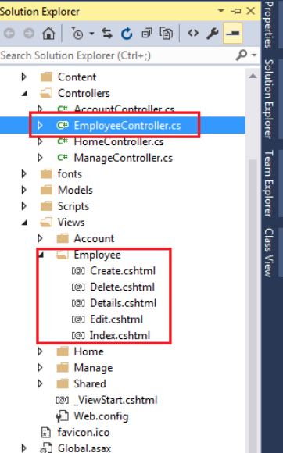
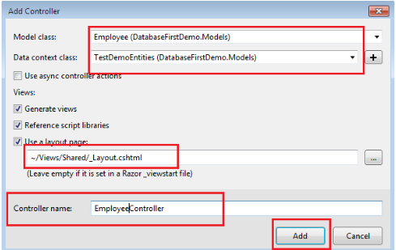
After adding EmployeeController. We can see here a Employee folder has been added inside the Views and all the view like Index.cshtml, edit.cshtml etc also has added.

Slide 27

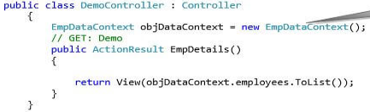
CRUD operations using EF Code-First approach
Create an ASP.NET Web application then, we have to create a domain class. Right-click on Models folder and add a class like an Employee class.
Add a DbContext class, for that, right-click the Models folder and add a class and give the name EmpDataContext
Next, we have to add a Controller. Go to Controllers folder and add a controller.
The controller has an Index Action method which is automatically created. Change it to a user-friendly method name. Now, create the object of your EmpDataContext class and write the logic for retrieval of the data.

Slide 28
Add a View for displaying the employee records. Right-click on action method and add a View.
Now, before the retrieval of data, we have to set our connection string in web.config file.
<connectionStrings>
<add name="MySqlConnection" connectionString="Data Source=MyPC;database=MyDemoDB;User Id=sa;Password=123;" providerName="System.Data.SqlClient" />
</connectionStrings>
Set the connection string in EmpDataContext class. If we don’t want to give manual connection string, then when running the project, it will automatically create the connection string with the same name as the class name of EmpDataContext class. If we create manually, then we have to pass our Connection String name in base class parameter.
Now, before the retrieval of data, we have to set our connection string in web.config file.

Slide 29
In Code First approach when we will run the project, at that moment automatically, it will create the Database and the Table; table name will be same as our domain Class name; as below my class name is Employee. Also, we can set the Primary key in SQL table from our program by using the Key class attribute in “[ ]” brackets. For using this functionality, we have to import the namespace like below.
using System.ComponentModel.DataAnnotations; (Import namespace)
using System.ComponentModel.DataAnnotations.Schema;
[Table("TblEmployee")]
public class Employee
{
[Key]
public int EmpId { get; set; }
public string Name { get; set; }
public string Address { get; set; }
public string Email { get; set; }
public string MobileNo { get; set; }
}

Slide 30
In Code First approach when we will run the project, at that moment automatically, it will create the Database and the Table; table name will be same as our domain Class name; as below my class name is Employee. Also, we can set the Primary key in SQL table from our program by using the Key class attribute in “[ ]” brackets. For using this functionality, we have to import the namespace like below.
Now, we will run the project and then check in SQL. Create the controllers and views manually and write down the CRUD operations to see the result.
using System.ComponentModel.DataAnnotations; (Import namespace)
using System.ComponentModel.DataAnnotations.Schema;
[Table("TblEmployee")]
public class Employee
{
[Key]
public int EmpId { get; set; }
public string Name { get; set; }
public string Address { get; set; }
public string Email { get; set; }
public string MobileNo { get; set; }
}

Slide 31
Books
Beginning ASP.NET 4: in C# and VB; Imar Spaanjaars,2010
Beginning ASP.NET 3.5 in C# 2008: From Novice to Professional; 2nd edition, Matthew MacDonald,2007
ASP.NET 3.5 Unleashed by Stephen Walther, 2008
Pro ASP.NET 3.5 in C# 2008: Includes Silverlight 2 by Matthew MacDonald,2008
ASP.NET 3.5 For Dummies by Ken Cox,2008

Slide 32
References
ASP.NET; URL: https://www.got-it.ai/solutions
URL: https://www.tutorialspoint.com/
URL: https://www.c-sharpcorner.com/aURL: https://www.tutorialsteacher.com/mvc
Entity framework; URL:https://www.entityframeworktutorial.net/
URL: https://www.tutlane.com/tutorial/aspnet-mv
URL: http://www.mukeshkumar.net/

Slide 33
Thank you!

